Slide 1

Object Selection
_______________________
_______________________
Student:
Nguyen Van Khoi
Tran Hoang Nam
Supervisor:
MSc. Tu Trung Hieu

Slide 2
Introduction
Literature review
Problem statement
Interactive graph cut segmentation
Silent Lazy Snapping solution
Experimental results
Future direction
Question and answer

Slide 3
Image selection
An image is a set of sub-images that sometimes referred to as regions-of-interest, ROIs, or simply regions.
One of the problem in image processing is image selection – how to cut out or select an area for later specific image processing operations.

Slide 4
Interactive single-image segmentation
Interactive single-image segmentation (image cutout or foreground/background separation), one of the typical case in region selection problem, is to select the object (e.g. human, flower) from the background that based on samples provided by the user.

Slide 5
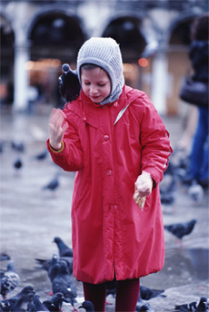
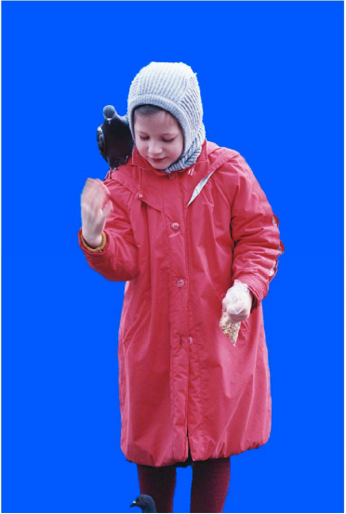
Image segmentation from Lazy Snapping paper

Slide 6
Introduction
Literature review
Problem statement
Interactive graph cut segmentation
Silent Lazy Snapping solution
Experimental results
Future direction
Question and answer

Slide 7
Graph cut for Interactive Segmentation
Based on the works of Greig et al., Exact maximum a posteriori estimation for binary images, 1989.
Region-based method
Constructing graph from image at pixel-detail level
Energy function combine both region and boundary properties

Slide 8
Lazy Snapping (Microsoft Research Asia - 2004)
Goal: separate object from background
First step: foreground/background selection
Sample are given by users in each part of image (draw strokes)
Solve minimum cut problem on segment level
Second step: boundary correction by Overriding brush or Direct vertex editing
User provides some strokes on incorrect parts of object
Solve minimum cut problem on pixel level

Slide 9
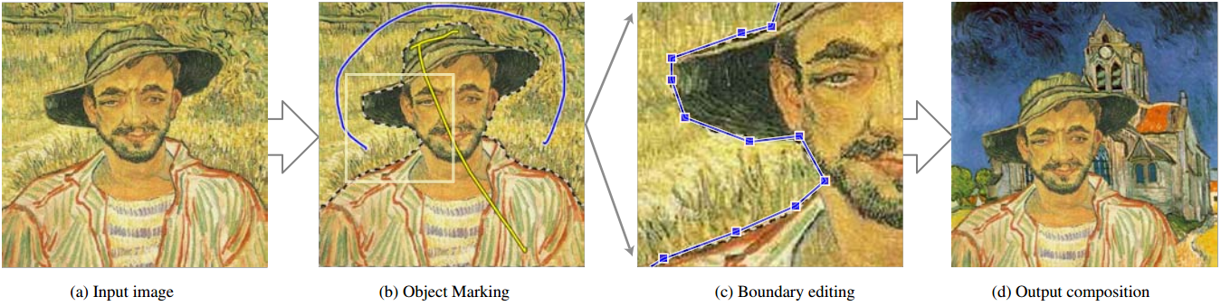
Lazy Snapping samples

Slide 10
GrabCut (Microsoft Research Cambridge – UK – 2004)
Goal: separate object from background
First step: foreground/background selection
Sample are given by users in each part of image (lasso, rectangle bounding box)
Solve minimum cut problem on segment level
Second step: boundary correction by border matting
User provides some strokes on incorrect parts of object
Solve minimum cut problem on pixel level

Slide 11
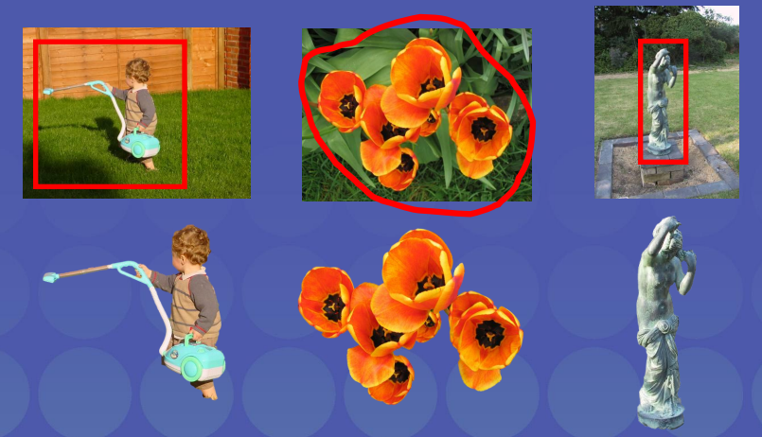
GrabCut samples

Slide 12
Introduction
Literature review
Problem statement
Interactive graph cut segmentation
Silent Lazy Snapping solution
Experimental results
Future direction
Question and answer

Slide 13
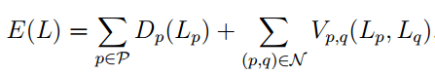
Binary labelling problem
Minimize the energy function (Greig et al., 1989)

Slide 14
Introduction
Literature review
Problem statement
Interactive graph cut segmentation
Silent Lazy Snapping solution
Experimental results
Future direction
Question and answer

Slide 15
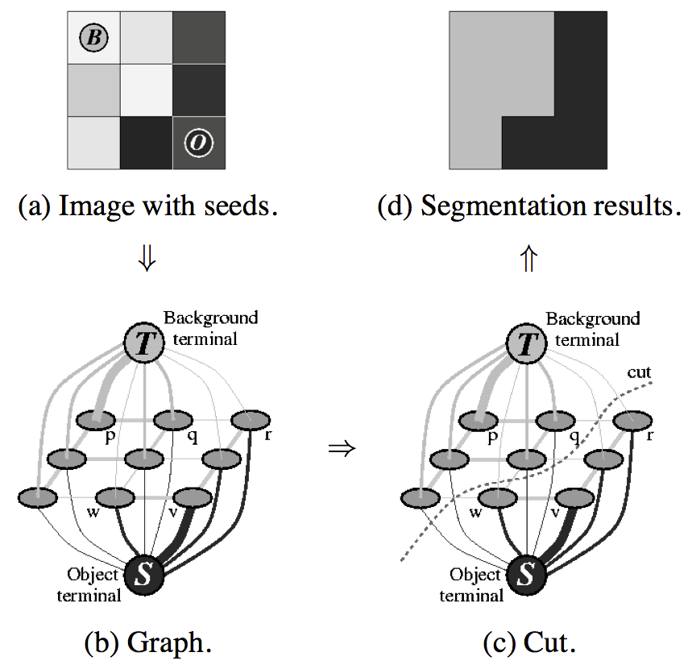
Graph cut construction
A simple segmentation example for a 3x3 image.

Slide 16
Energy function

Slide 17
Energy function (cont.)

Slide 18
Detailed implementation
Negative log-likelihood of intensity for regional term
Ad hoc function for boundary term
Max-flow algorithm provided by Boykov and Kolgomorov (2001)

Slide 19
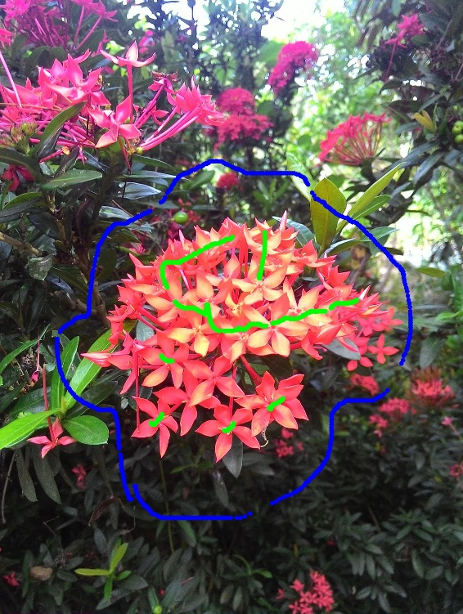

Sample result and comment

Slide 20
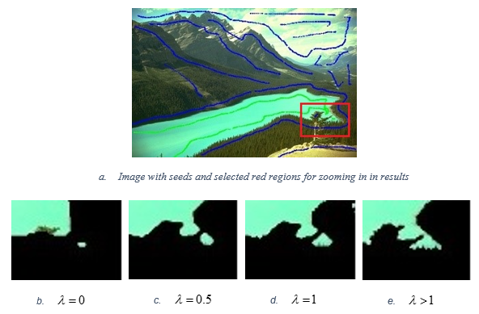
Sample result and comment (cont.)

Slide 21
Introduction
Literature review
Problem statement
Interactive graph cut segmentation
Silent Lazy Snapping solution
Experimental results
Future direction
Question and answer

Slide 22
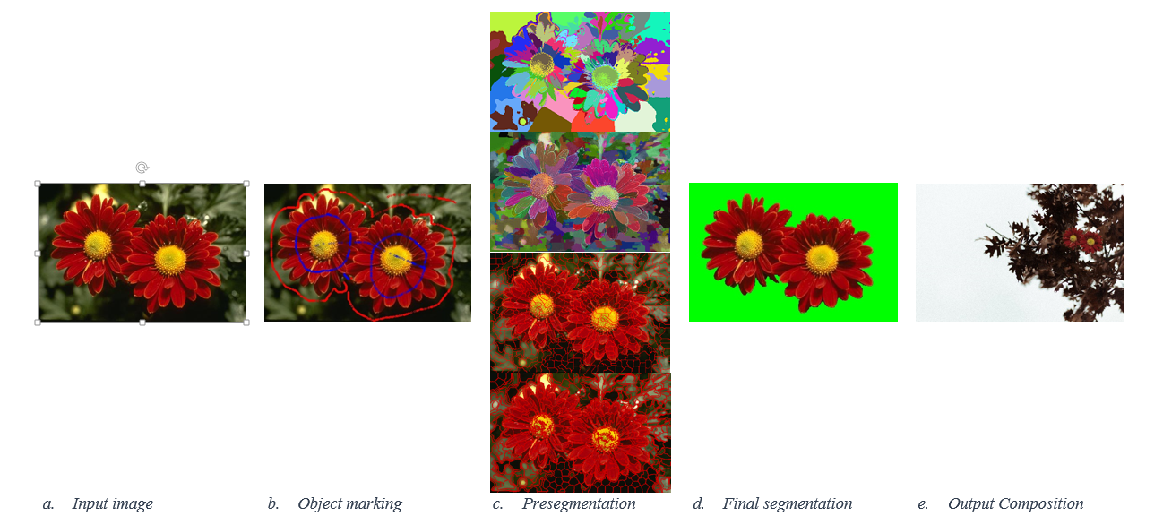
Silent Lazy Snapping model

Slide 23
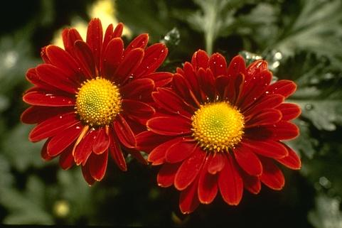
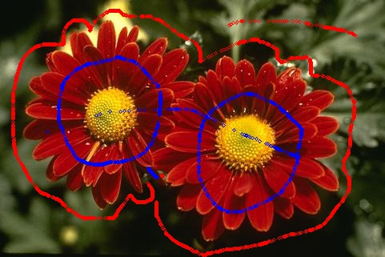
Step 1: Sample definition

Slide 24
Sample definition step
User action:
Visualize examples by drawing strokes/points in input image.

Slide 25
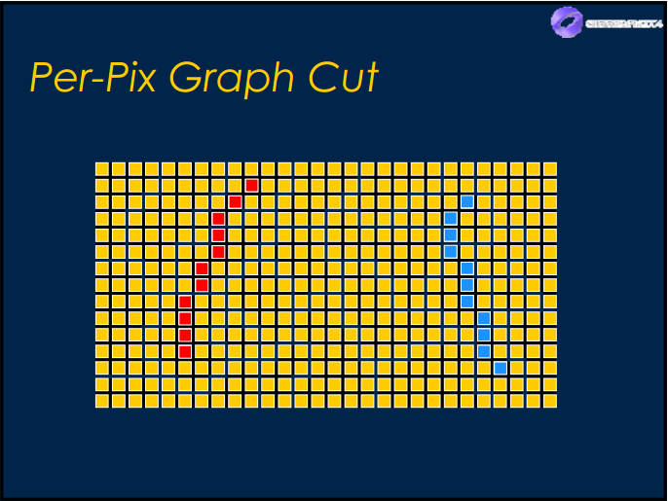
Sample definition step
Sample definition in pixel level:
Blue color: pixel belongs to foreground/object.
Red color: pixel belongs to background.

Slide 26
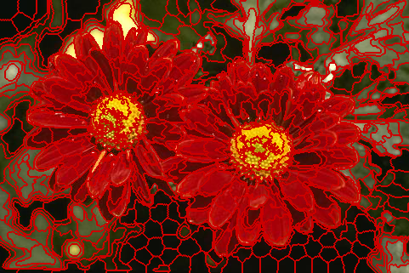
Step 2: Pre-segmentation by SEEDs algorithm

Slide 27
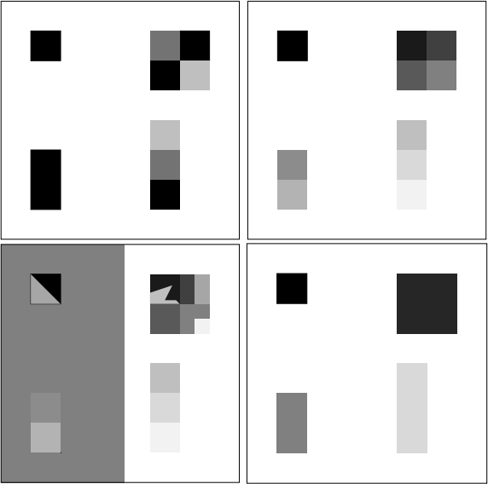
Over-segmentation: pixels belong to same object are classified as belonging to different segments. A single object may be represented by two or more segments.

Slide 28
Under-segmentation: pixels belong to different objects are classified as belonging to the same object. A single segment may contain several objects.

Slide 29

Pre-segmentation step K-means method (4124 segments)
Cannot control the number of segments.
Over-segmentation problem.
Easy to implement, but require time and memory.

Slide 30
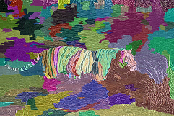
Pre-segmentation step Watershed method (212 segments)
Cannot control the number of segments.
Under-segmentation problem.
Unstable because result depends on threshold value.

Slide 31
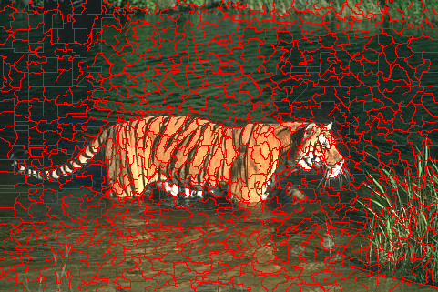
Pre-segmentation step SEEDs – Super pixel (800 segments)
Can control the number of segments.
Depend on the number of iteration.
Under-fitting boundary problem.

Slide 32
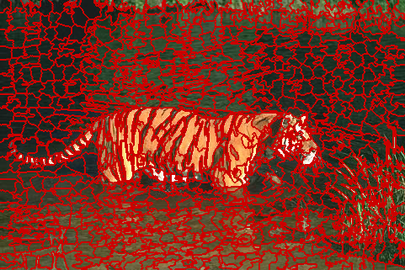
Pre-segmentation step SEEDs – Revised Mean Pixel (800 segments)
Can control the number of segments.
Depend on the number of iteration.
Stable, usable result.

Slide 33
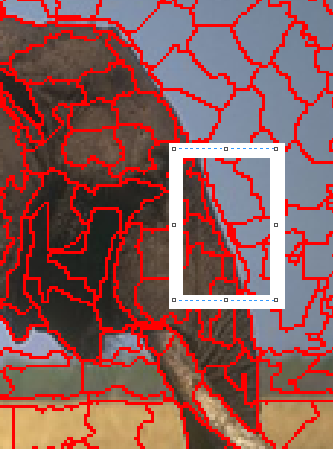
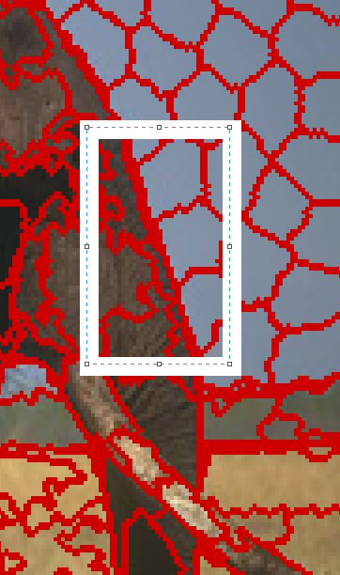
Comparison between SEEDs Super Pixel and SEEDs Revised Mean Pixel
SEEDs Super Pixel
SEEDs Revised Mean Pixel

Slide 34
Why SEEDs Revised Mean Pixels?
Can control the number of segments.
Can control the number of iteration.
Avoid over/under segmentation problem.
Avoid under-fitting boundary problem.
Linear complexity: O(5*N) (N – number of pixel in the original image)

Slide 35
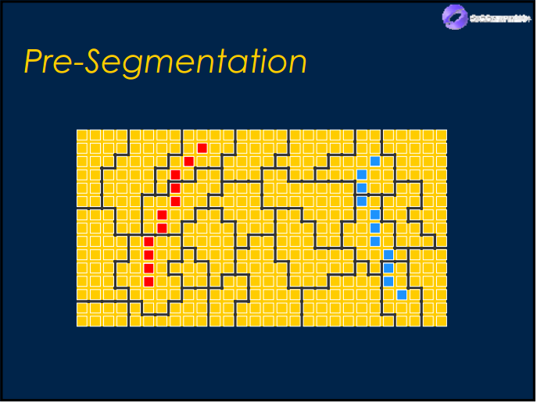
Pre-segmentation step
Segments combine with sample definition in pixel level:
Blue color: pixel belongs to foreground/object.
Red color: pixel belongs to background.

Slide 36
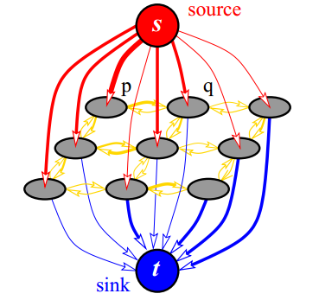
Step 3: Graph initialization

Slide 37
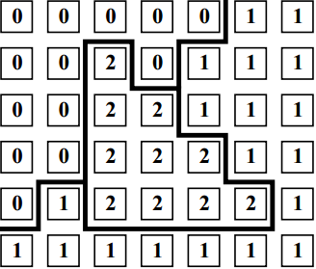
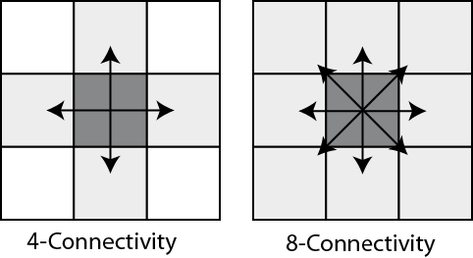
Network properties
Network G = (V, E)
V = {source, sink, segments}
|V| = number of segments + 2
I(u) = mean value of segment u
E = {t-link, n-link}
If pixel p with label L[p] is a neighbor of pixel q with label L[q] and L[p] <> L[q], so p and q are neighbor in the network.
If pixel p belongs to foreground sample, we mark vertex L[p] connect to source.
If pixel q belongs to background sample, we mark vertex L[q] connect to sink.

Slide 38
T-link cost
Use K-means method to cluster the color of foreground seeds and background seeds .
The mean colors of each set are denote as and .
Each node has its color .

Slide 39
N-link cost
is the L2-Norm of RGB color difference between two pixels p and q.
More detailed, we use Euclidean distance to compute .

Slide 40
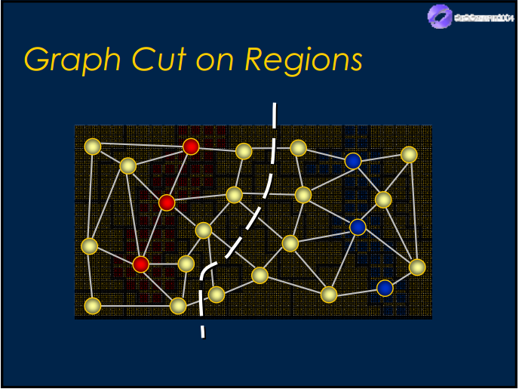
Step 4: Graph cut and final segmentation

Slide 41
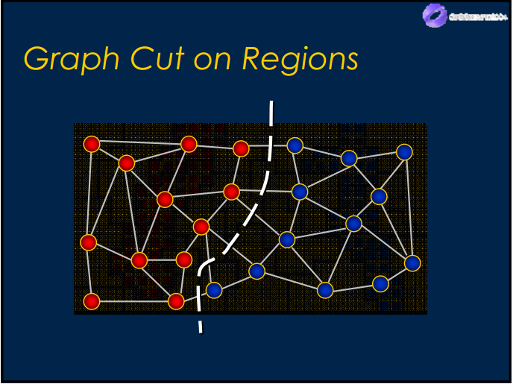
Final segmentation
We apply Graph Cut solution of Yuri Boykov and Vladimir Kolmogorov to the network to solve maximum flow problem.

Slide 42
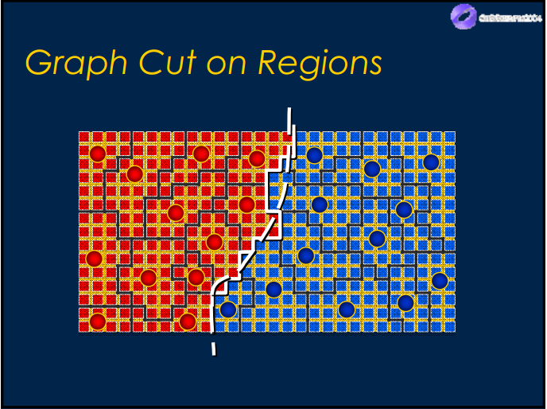
Final segmentation
We transfer label value of vertices back to all regions in the original image, change color or background regions to get final segmentation – object selection.

Slide 43

Sample result

Slide 44
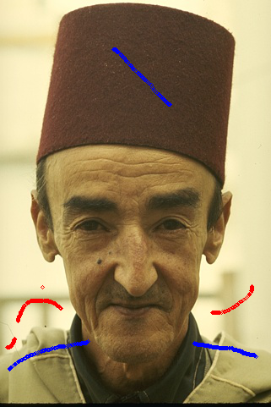

Limitation 1: Pixel loss in thin area
189080 with samples
Final segmentation

Slide 45
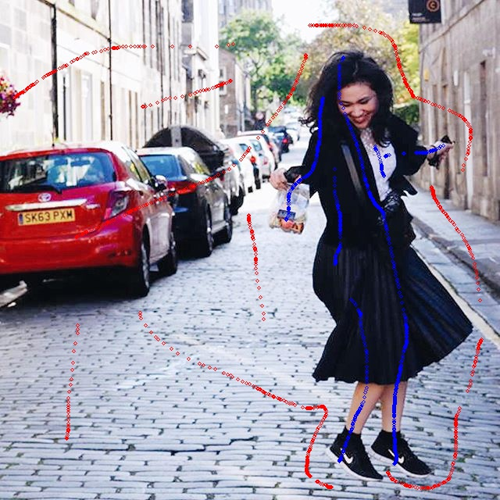
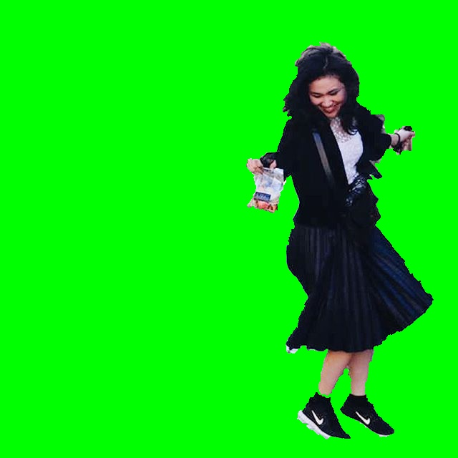
Limitation 2: Unsmooth boundary
Dancing_Emily with samples
Final segmentation

Slide 46
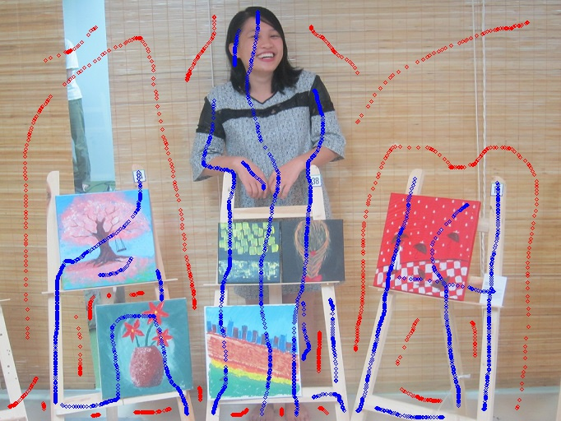
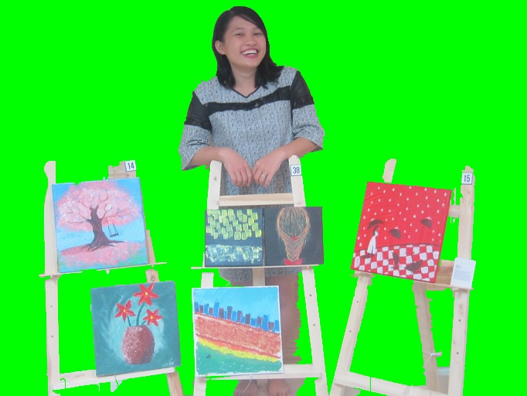
Limitation 3: Poor performance when foreground and background have similar color distribution
Vango with samples
Final segmentation

Slide 47
Introduction
Literature review
Problem statement
Interactive graph cut segmentation
Silent Lazy Snapping solution
Experimental results
Future direction
Question and answer

Slide 48
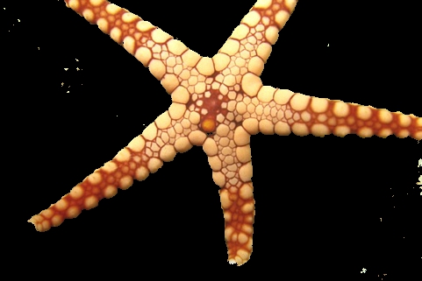
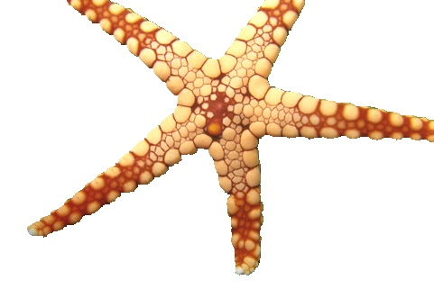
Berkeley dataset – 12003.jpg
Interactive Graph Cut
Silent Lazy Snapping

Slide 49

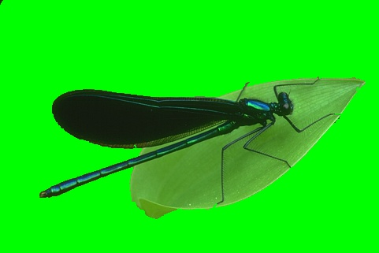
Berkeley dataset – 35070.jpg
Interactive Graph Cut
Silent Lazy Snapping

Slide 50

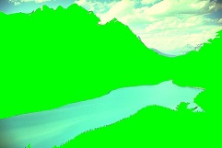
Berkeley dataset – 176035.jpg
Interactive Graph Cut
Silent Lazy Snapping

Slide 51


Berkeley dataset – 187029.jpg
Interactive Graph Cut
Silent Lazy Snapping

Slide 52
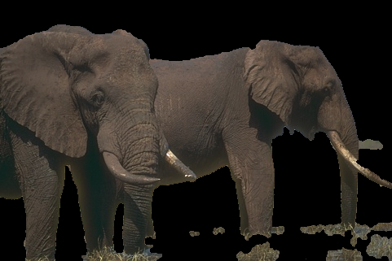
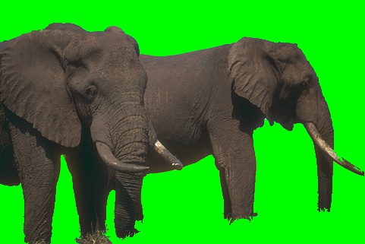
Berkeley dataset – 207056.jpg
Interactive Graph Cut
Silent Lazy Snapping

Slide 53
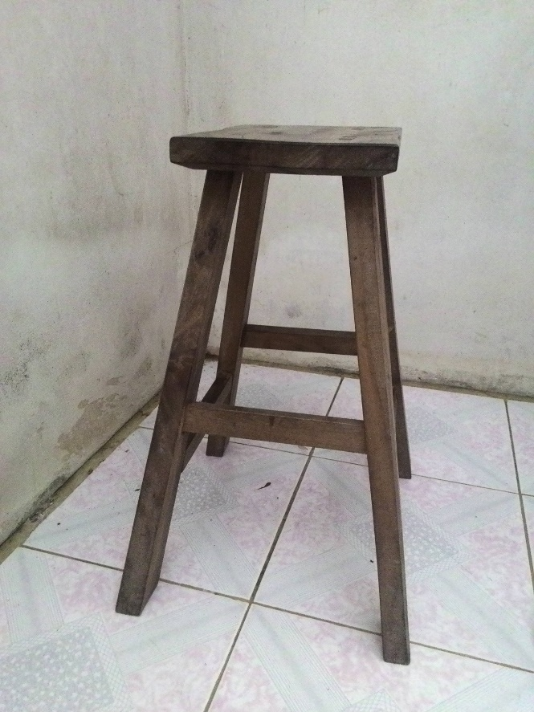
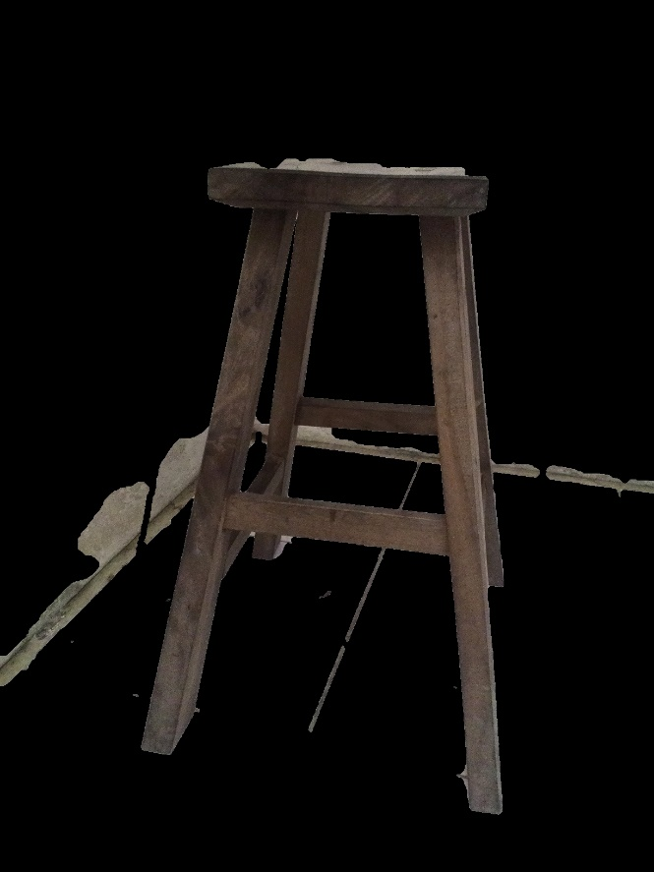
Khoi’s dataset – 5.jpg
Original Image
Interactive Graph Cut

Slide 54

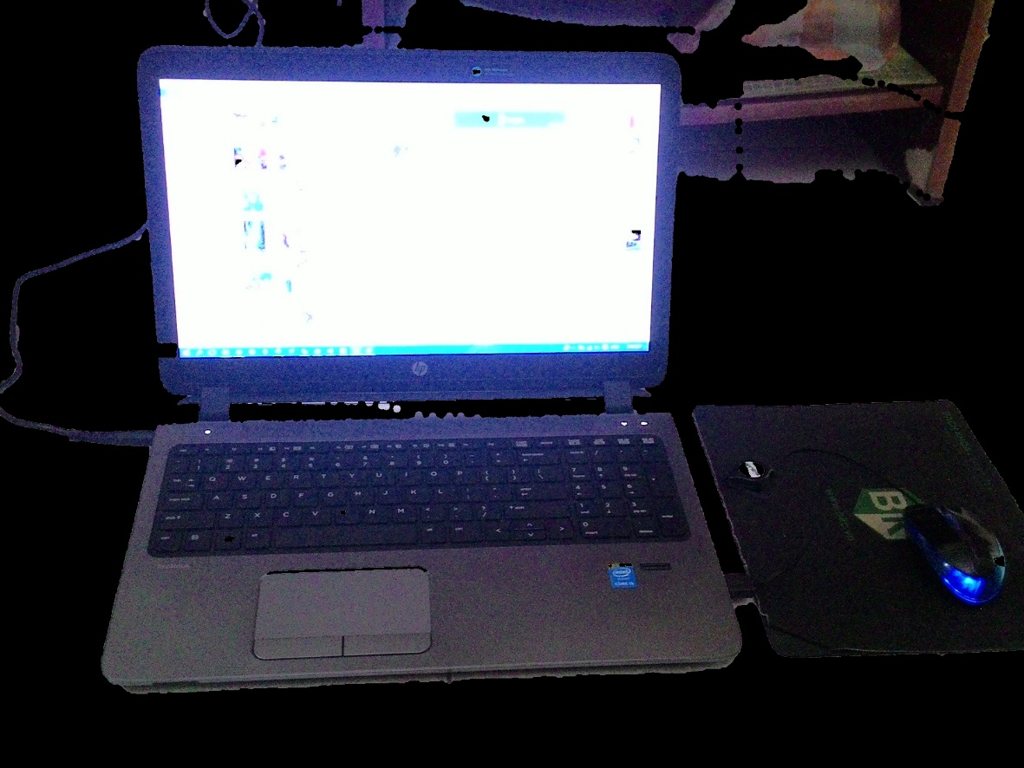
Khoi’s dataset – 6.jpg
Original Image
Interactive Graph Cut

Slide 55
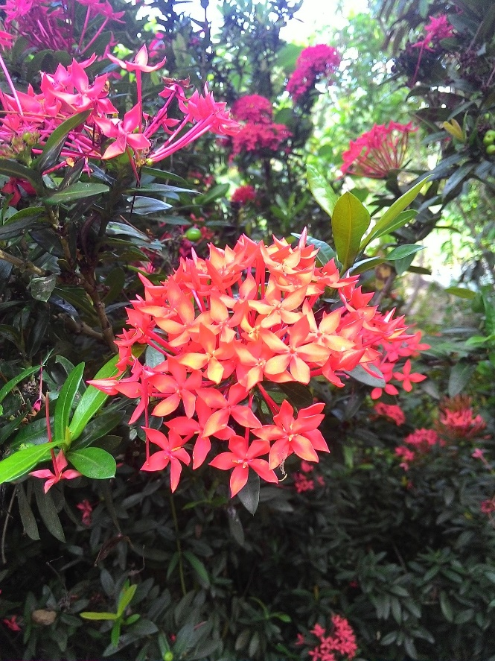

Khoi’s dataset – 7.jpg
Original Image
Interactive Graph Cut

Slide 56
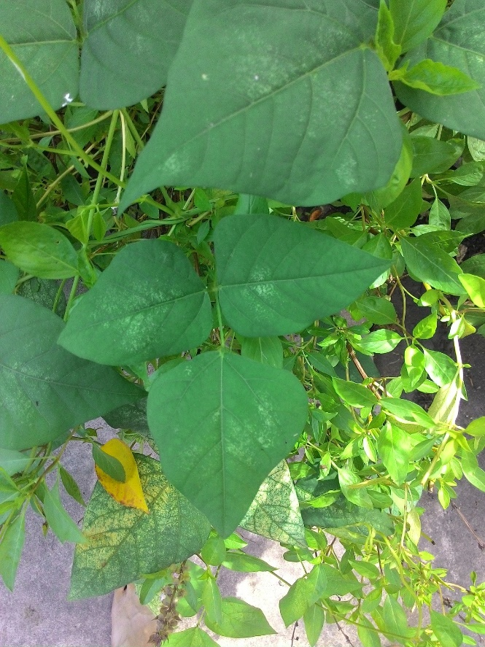
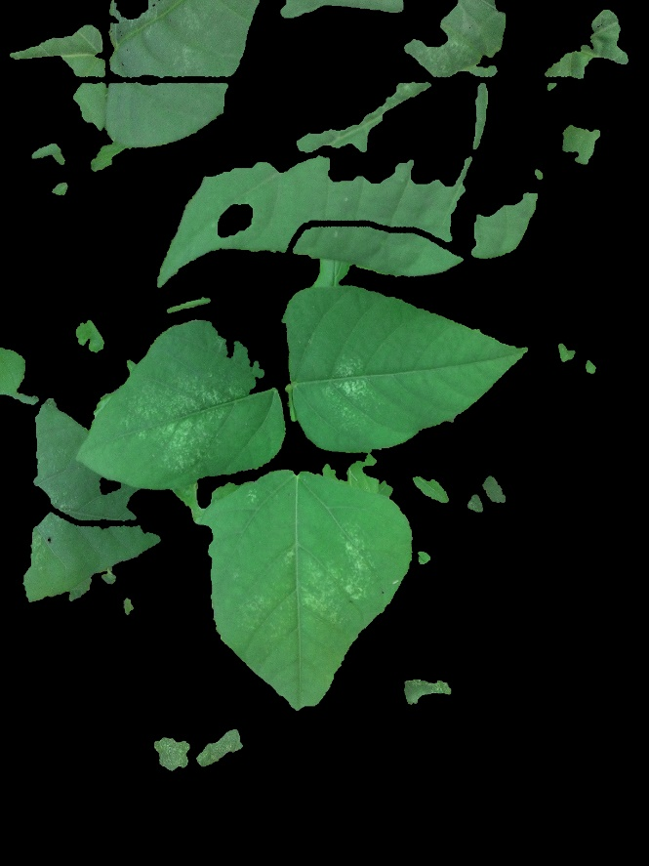
Khoi’s dataset – 8.jpg
Original Image
Interactive Graph Cut

Slide 57
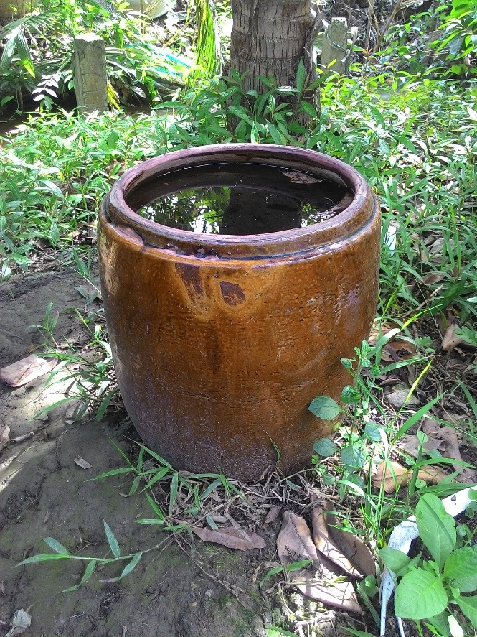
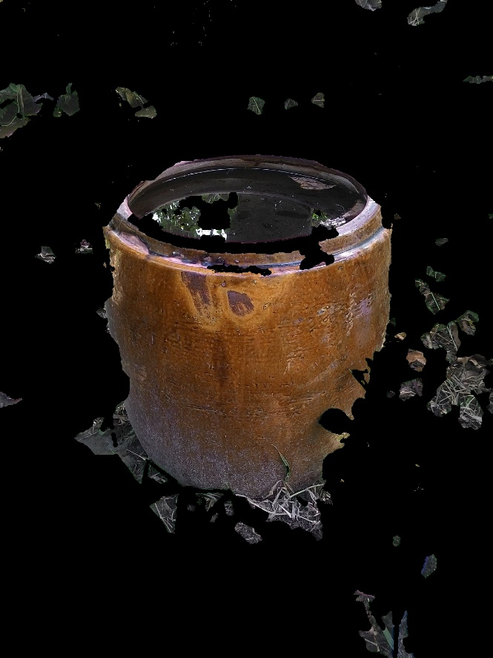
Khoi’s dataset – 9.jpg
Original Image
Interactive Graph Cut

Slide 58

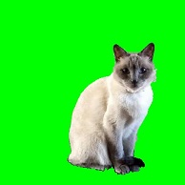
Nam’s dataset – Cat.jpg
Original Image
Silent Lazy Snapping

Slide 59


Nam’s dataset – TrangAn.jpg
Original Image
Silent Lazy Snapping

Slide 60

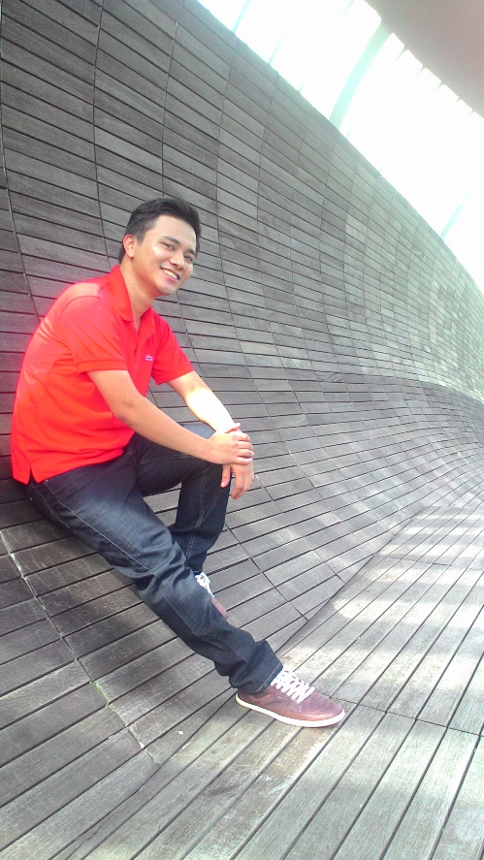
Nam’s dataset – Nam_2.jpg
Original Image
Silent Lazy Snapping

Slide 61

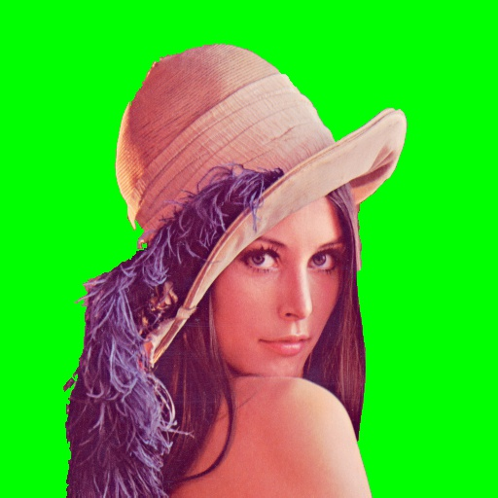
Nam’s dataset – WSpaper.jpg
Original Image
Silent Lazy Snapping

Slide 62


Nam’s dataset – Emily_child.jpg
Original Image
Silent Lazy Snapping

Slide 63
Introduction
Literature review
Problem statement
Interactive graph cut segmentation
Silent Lazy Snapping solution
Experimental results
Future direction
Question and answer

Slide 64
Introduction
Literature review
Problem statement
Interactive graph cut segmentation
Silent Lazy Snapping solution
Experimental results
Future direction
Question and answer

Slide 65
THANK YOU FOR LISTENING!

